Slide 1
List
STW300CEM Android Application Development

Slide 2
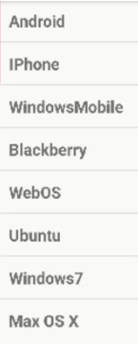
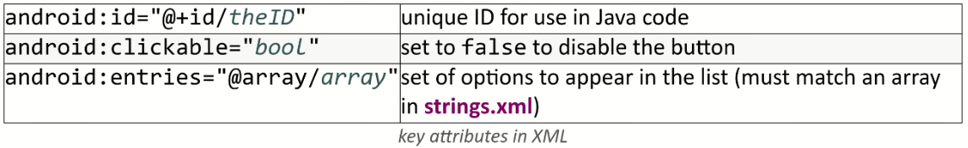
ListView
An ordered collection of selectable choices

Slide 3
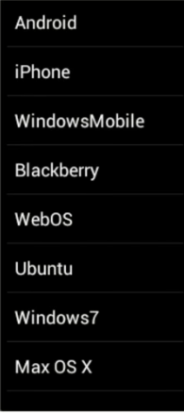
Types of List
Static List : content is fixed and known before the app runs.
Declare the list elements in the string.xml resource file.
Dynamic List : Content is read or generated as the program runs.
Come from a data file, or from the internet , etc.
Must be set in java code.

Slide 4
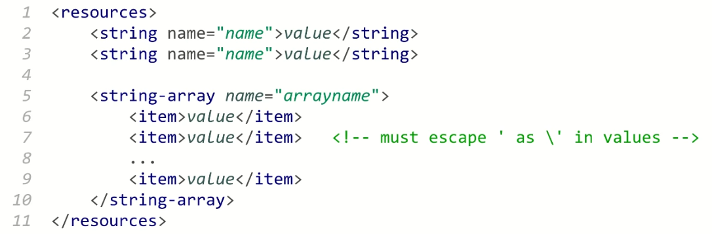
String resources
Declare constant strings and arrays in res/values/strings.xml
Refer to them in java code :
As a resource : R.string.name , R.array.name
As a string or array : getResources().getString(R.string.name) ,
getResources().getStringArray(R.string.name)

Slide 5
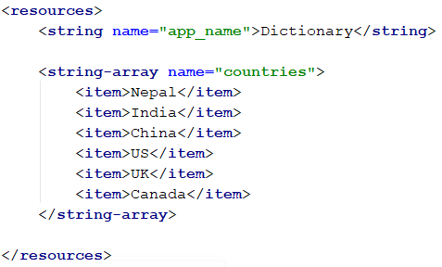
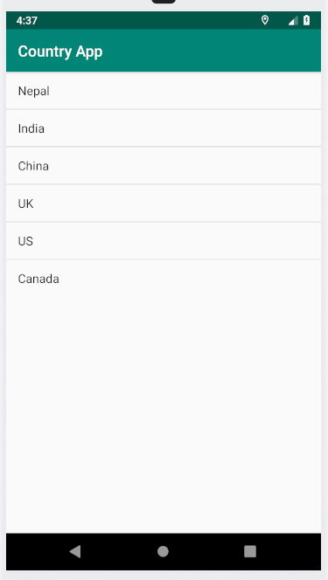
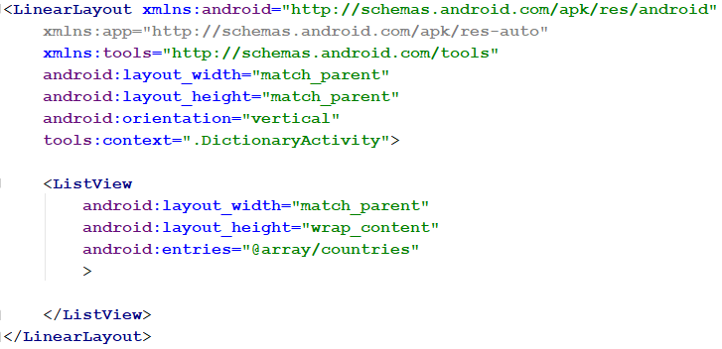
Static List : Example
string.xml
Layout.xml

Slide 6
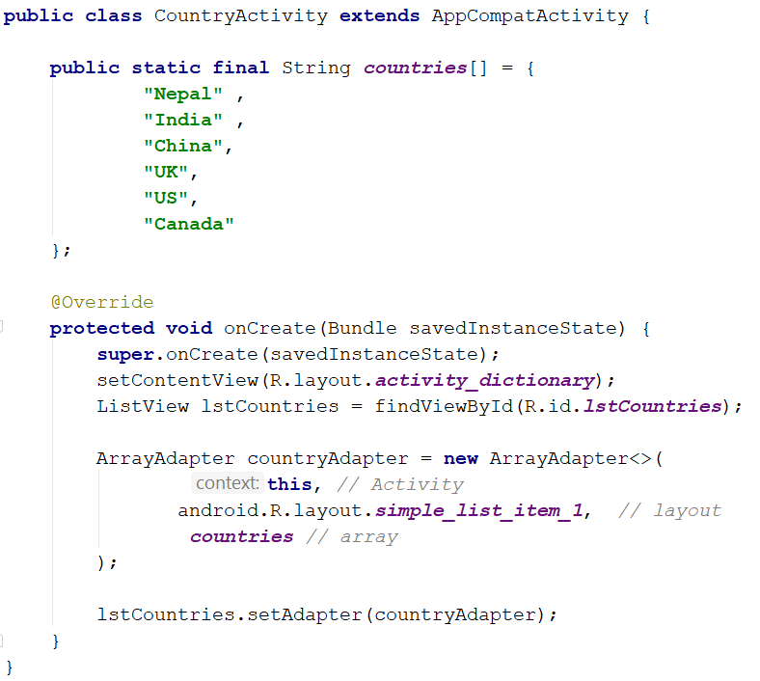
Using java code

Slide 7
List Adapters
adapter : Helps turn list data into list view items.
Common adapters
ArrayAdapter : item come from an array or list.
CursorAdapter : items come from a database query
Syntax for creating an adapter

Slide 8
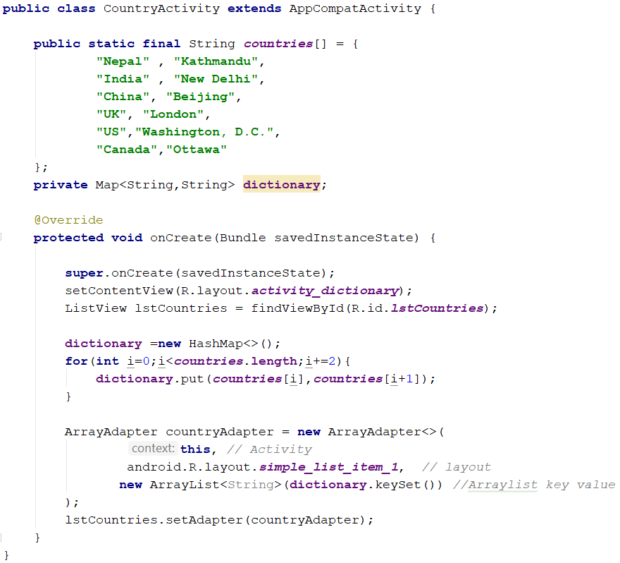
Dictionary App

Slide 9
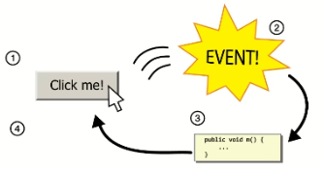
Handling list events
List don’t use the onClick event.
Event listeners must be attached in java, not XML
We must use Java anonymous inner classes.
anonymous inner classes : A shorthand syntax for declaring a small class without giving it an explicit name.

Slide 10
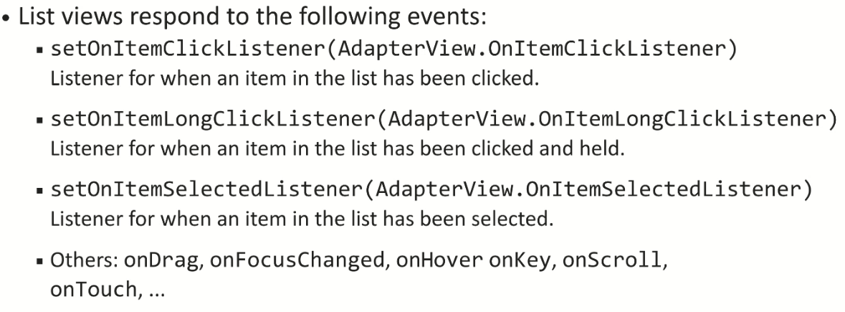
List events

Slide 11
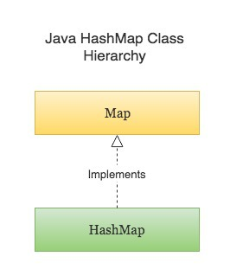
HashMap
Java HashMap is a hash table based implementation of Java’s Map interface. A Map, as you might know, is a collection of key-value pairs. It maps keys to values.
Following are few key points to note about HashMaps in Java –
A HashMap cannot contain duplicate keys.
Java HashMap allows null and the null key.
HashMap is an unordered collection. It does not guarantee any specific
order of the elements.
Java HashMap is not thread-safe. You must explicitly synchronize concurrent modifications to the HashMap.

Slide 12
HashMap
It uses HashCode

Slide 13
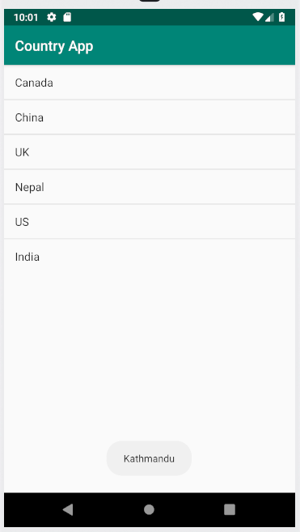
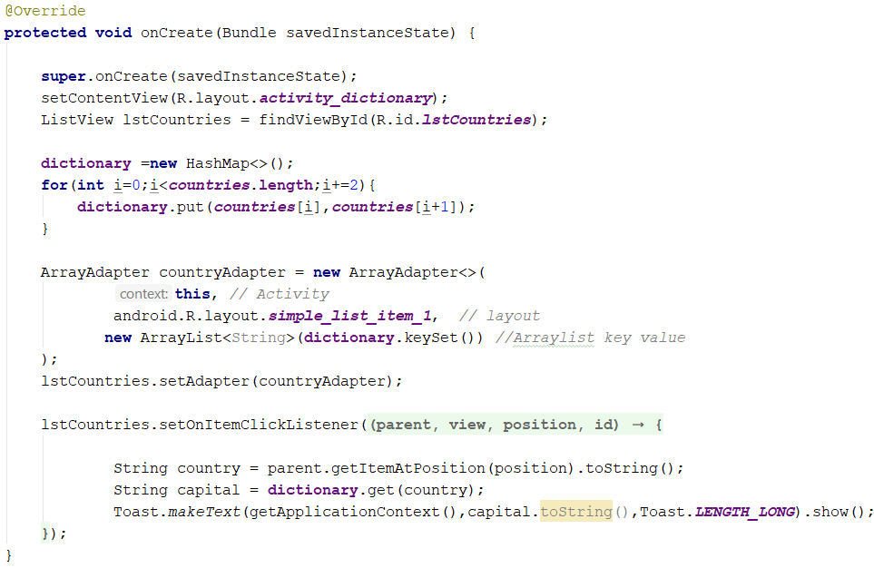
Dictionary App

Slide 14
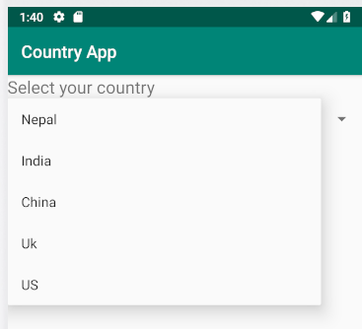
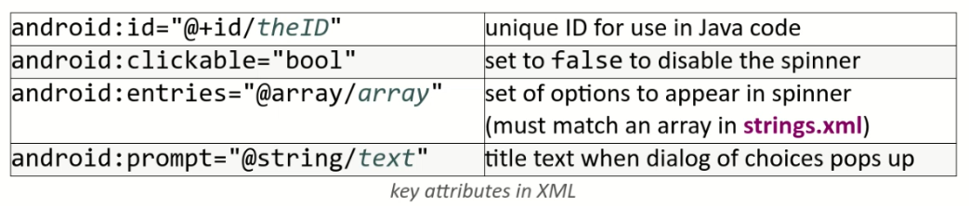
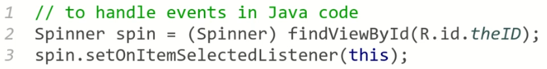
Spinner
A drop-down menu of selectable items.

Slide 15
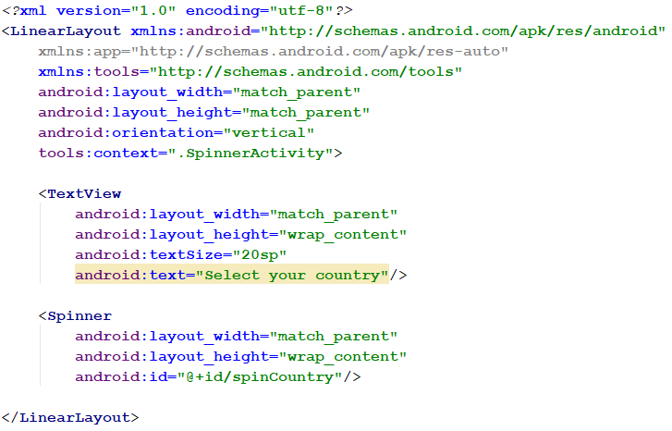
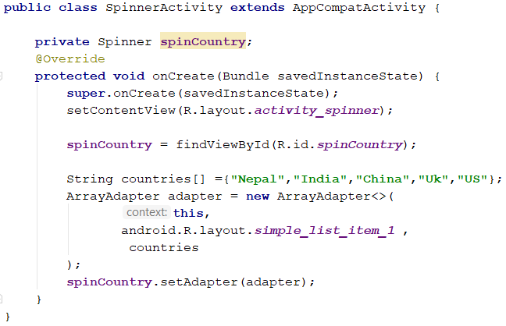
Spinner

